Slide 1
How to command a trajectory to an AV in SUMO
Wushuang Bai

Slide 2
The purpose of this presentation is to show how to command an AV to drive based on a trajectory. This presentation described three examples:
Commanded a straight line trajectory to an AV
Commanded a simple curved trajectory to an AV
Commanded a complex irregular-shaped curved trajectory to an AV

Slide 3
Example 1: commanded a straight line trajectory to an AV. Test description is below.
Input:
Commanded trajectory containing x and y in meters
Source data file: straightlineTrajectory_Input.csv
Output:
Actual trajectory containing x and y in meters.
Source data file: straightlineTrajectory_Output.csv
Script used:
script_testFcn_fcn_CommandVehTrajectory.py
fcn_CommandVehTrajectory.py
Other data files used:
straightlineTrajectory.sumocfg - this runs the simulation
straightlineTrajectory.net.xml - this describes SUMO road network
straightlineTrajectory.rou.xml - this describes simulation route

Slide 4
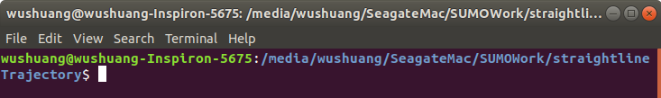
Step 1. Navigate to the folder of data files and script, open a terminal.

Slide 5
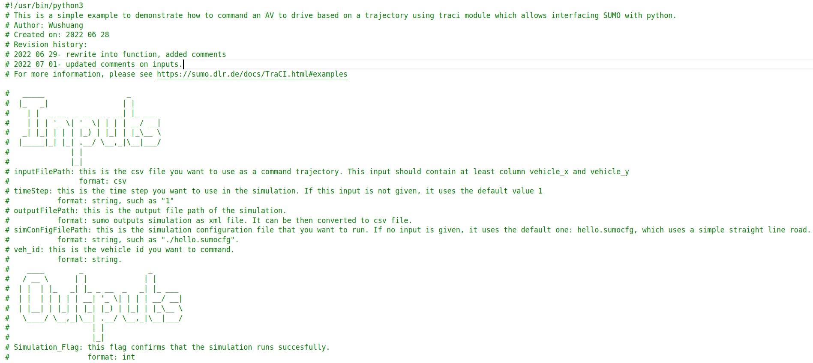
Step 2. Run the script by running command "python3 script_testFcn_fcn_CommandVehTrajectory.py". This script calls the function fcn_CommandVehTrajectory.py, which calls SUMO using python API, takes user's input of commanded trajectory in x and y, and run the simulation.

Slide 6
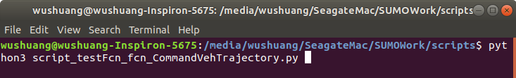
Step 2. Run the script by running command "python3 script_testFcn_fcn_CommandVehTrajectory.py". This script calls the function fcn_CommandVehTrajectory.py, which calls SUMO using python API, takes user's input of commanded trajectory in x and y, and run the simulation.
Note that in this example, the inputs given to the script are:
InputFilePath = "./straightlineTrajectory_Input.csv"
OutputFilePath = "./straightlineTrajectory_Output.csv"
SimConfigFilePath = "./straightlineTrajectory.sumocfg"
Veh_id = "veh0"

Slide 7
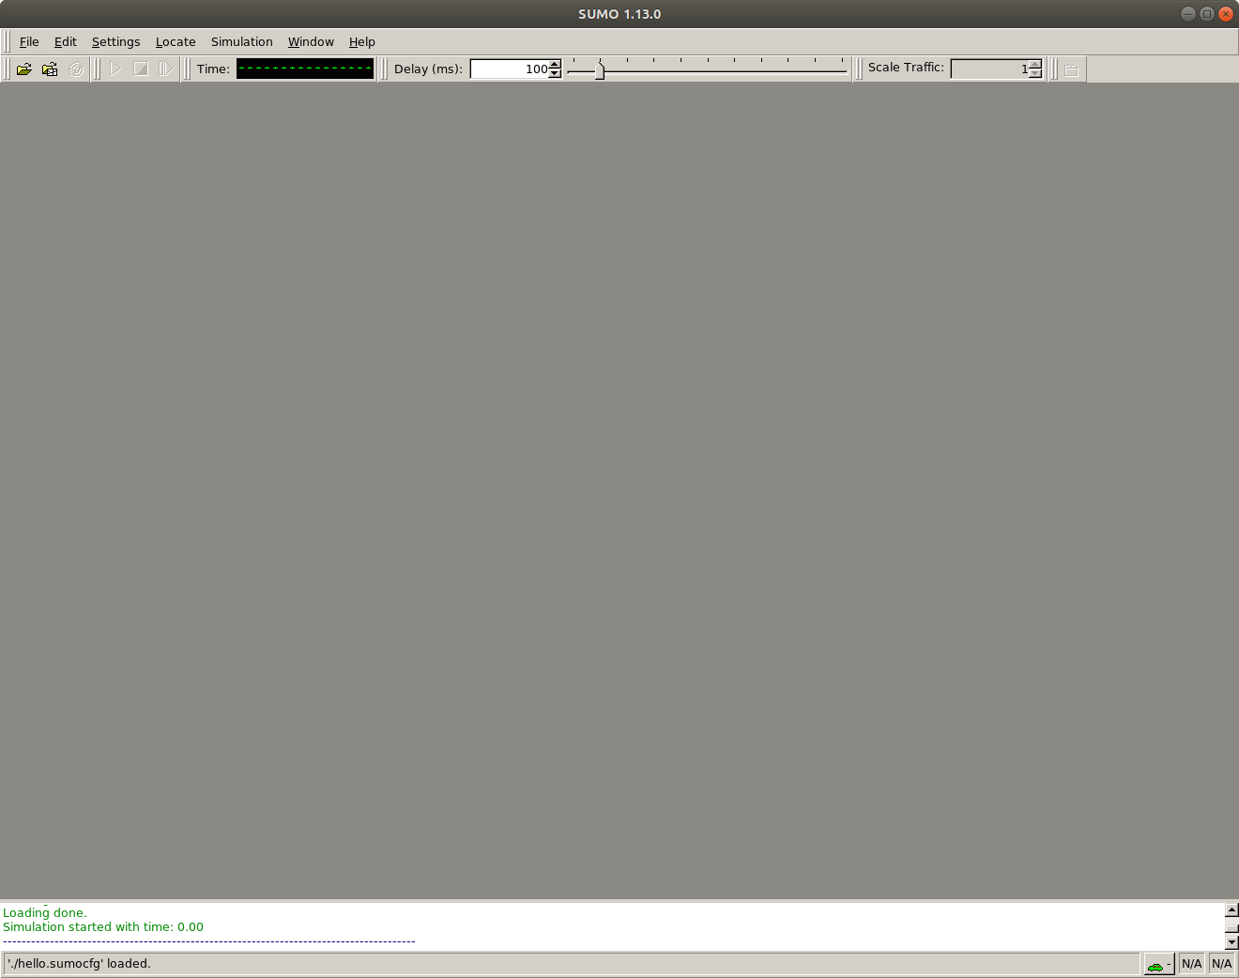
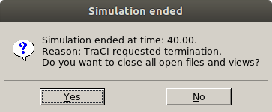
Step 3. Once simulation ends, close SUMO to end the script. Please note that you have to close SUMO to end the script so that output file can be written.

Slide 8
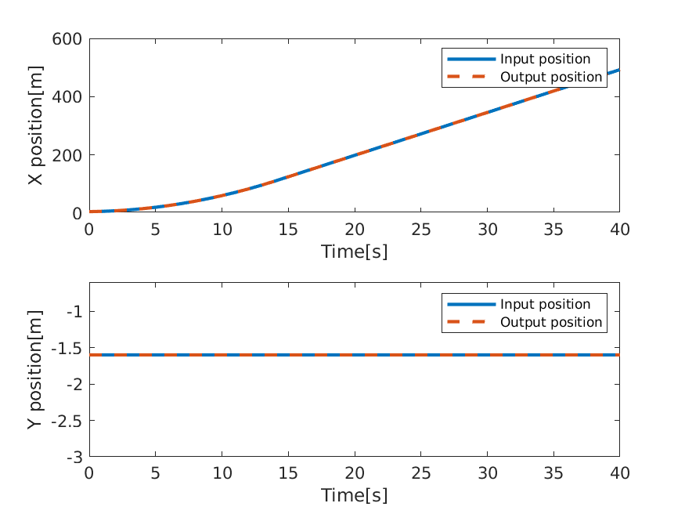
Step 4. Investigating the results. In this example, input trajectory is a straight line. The results show that the actual output trajectory matches the input trajectory. Please note that the output file is in xml format. For how to convert it from xml to csv,please see the document "How to export SUMO simulation results.pptx"
Simulated road in SUMO

Slide 9
Example 2: commanded a simple curved trajectory to an AV. Test description is below.
Input:
Commanded trajectory containing x and y in meters
Source data file: curvyRoadSimpleTrajectory_Input.csv
Output:
Actual trajectory containing x and y in meters.
Source data file: curvyRoadSimpleTrajectory_Output.csv
Script used:
script_testFcn_fcn_CommandVehTrajectory.py
fcn_CommandVehTrajectory.py
Other data files used:
curvyRoadSimpleTrajectory.sumocfg - this runs the simulation
curvyRoadSimpleTrajectory.net.xml - this describes SUMO road network
curvyRoadSimpleTrajectory.rou.xml - this describes simulation route

Slide 10
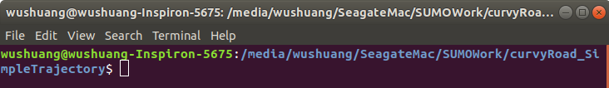
Step 1. Navigate to the folder of data files and script, open a terminal.

Slide 11
Step 2. Run the script by running command "python3 script_testFcn_fcn_CommandVehTrajectory.py". This script calls the function fcn_CommandVehTrajectory.py, which calls SUMO using python API, takes user's input of commanded trajectory in x and y, and run the simulation.

Slide 12
Step 2. Run the script by running command "python3 script_testFcn_fcn_CommandVehTrajectory.py". This script calls the function fcn_CommandVehTrajectory.py, which calls SUMO using python API, takes user's input of commanded trajectory in x and y, and run the simulation.
Note that in this example, the inputs given to the script are:
InputFilePath = "./curvyRoadSimpleTrajectory_Input.csv"
OutputFilePath = "./curvyRoadSimpleTrajectory_Output.csv"
SimConfigFilePath = "./curvyRoadSimpleTrajectory.sumocfg"
Veh_id = "veh_0"

Slide 13
Step 3. Once simulation ends, close SUMO to end the script. Please note that you have to close SUMO to end the script so that output file can be written.

Slide 14
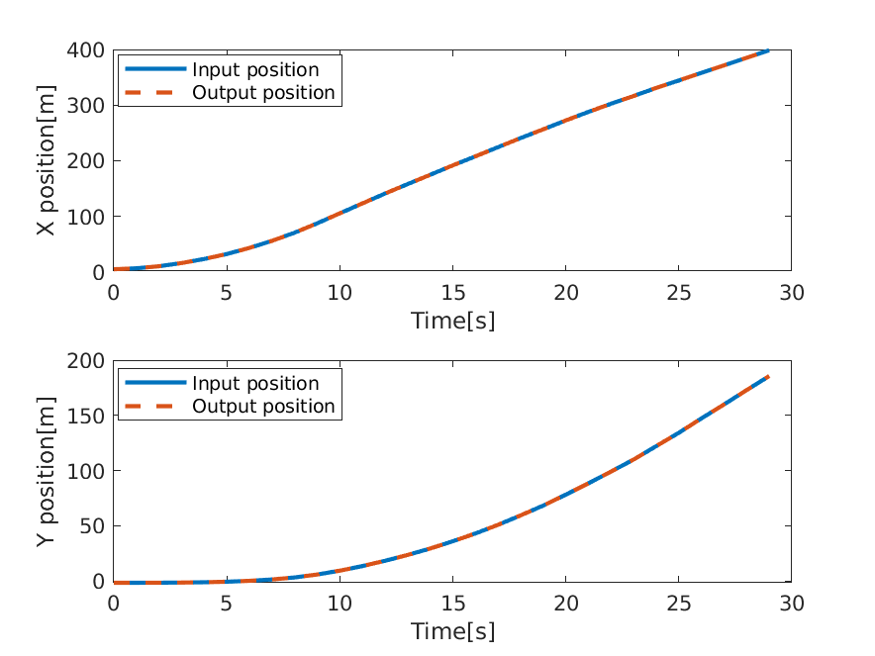

Step 4. Investigating the results. In this example, input trajectory is a simple curved line. The results show that the actual output trajectory matches the input trajectory. Please note that the output file is in xml format. For how to convert it from xml to csv, please see the document "How to export SUMO simulation results.pptx"
Simulated road in SUMO

Slide 15
Example 3: commanded a complex irregular-shaped curved trajectory to an AV. Test description is below.
Input:
Commanded trajectory containing x and y in meters
Source data file: curvyRoad_irregularShapeTrajectory_Input.csv
Output:
Actual trajectory containing x and y in meters.
Source data file: curvyRoad_irregularShapeTrajectory_Output.csv
Script used:
script_testFcn_fcn_CommandVehTrajectory.py
fcn_CommandVehTrajectory.py
Other data files used:
curvyRoad_irregularShapeTrajectory.sumocfg - this runs the simulation
curvyRoad_irregularShapeTrajectory.net.xml - this describes SUMO road network
curvyRoad_irregularShapeTrajectory.rou.xml - this describes simulation route

Slide 16
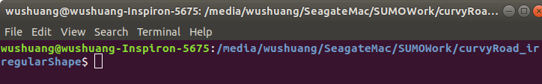
Step 1. Navigate to the folder of data files and script, open a terminal.

Slide 17
Step 2. Run the script by running command "python3 script_testFcn_fcn_CommandVehTrajectory.py". This script calls the function fcn_CommandVehTrajectory.py, which calls SUMO using python API, takes user's input of commanded trajectory in x and y, and run the simulation.

Slide 18
Step 2. Run the script by running command "python3 script_testFcn_fcn_CommandVehTrajectory.py". This script calls the function fcn_CommandVehTrajectory.py, which calls SUMO using python API, takes user's input of commanded trajectory in x and y, and run the simulation.
Note that in this example, the inputs given to the script are:
InputFilePath = "./curvyRoad_irregularShapeTrajectory_Input.csv"
OutputFilePath = "./curvyRoad_irregularShapeTrajectory_Output.csv"
SimConfigFilePath = "./curvyRoad_irregularShapeTrajectory.sumocfg"
Veh_id = "veh_0"

Slide 19
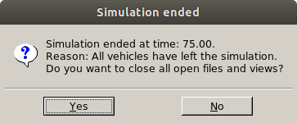
Step 3. Once simulation ends, close SUMO to end the script. Please note that you have to close SUMO to end the script so that output file can be written.

Slide 20

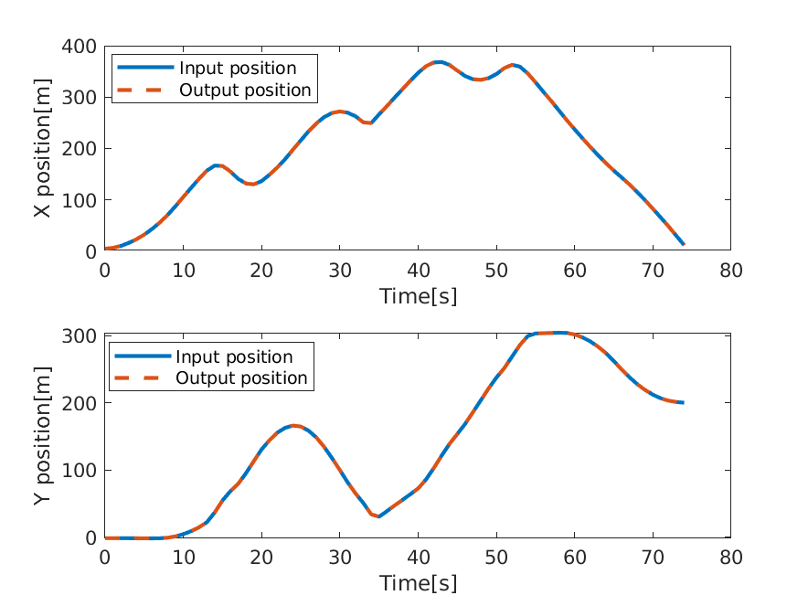
Step 4. Investigating the results. In this example, input trajectory is a complex irregular-shaped curved line. The results show that the actual output trajectory matches the input trajectory. Please note that the output file is in xml format. For how to convert it from xml to csv, please see the document "How to export SUMO simulation results.pptx"
Simulated road in SUMO

Slide 21
Files used in this document can be found:
Data files can be found: https://github.com/ivsg-psu/TrafficSimulators_GettingStartedWithDifferrentSimulators_GettingStartedWithSUMO/tree/main/Data/
Script can be found: https://github.com/ivsg-psu/TrafficSimulators_GettingStartedWithDifferrentSimulators_GettingStartedWithSUMO/tree/main/Code
For more information, please see:
https://sumo.dlr.de/docs/TraCI.html
https://sumo.dlr.de/docs/TraCI/Change_Vehicle_State.html

